Slide 1
Transformer Models
Julia Ive

Slide 2
Session Outline
Attention
Self-Attention
Multi-Head Self-Attention
Positional Encoding
Key Takeaways
Learning Outcomes
Being familiar with concepts of attention and self-attention
Being familiar with the BERT model and its training procedure

Slide 3
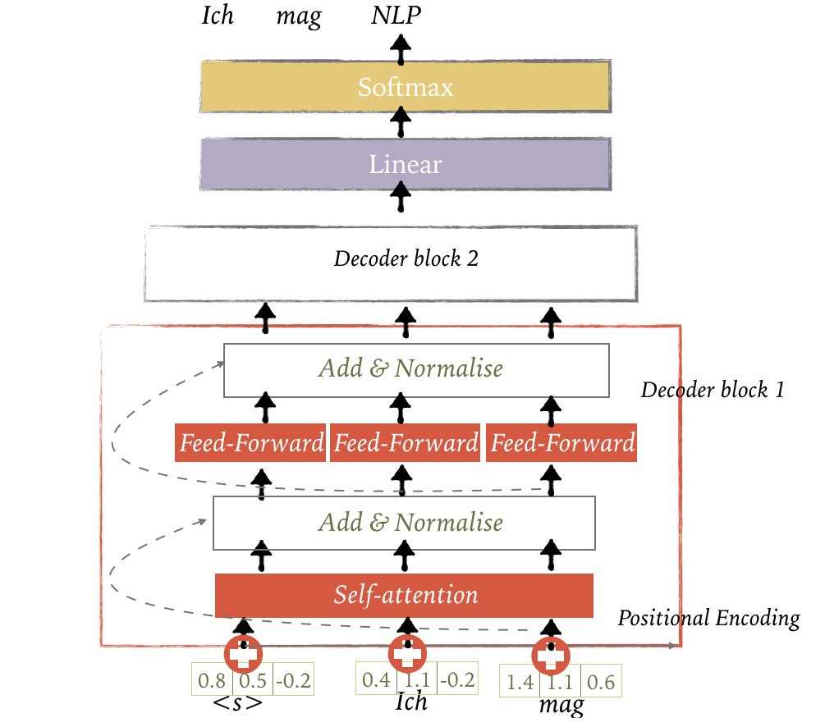
Transformer Language Model

Slide 4
Attention
Mechanism that at each time-step of decoding, focuses on a particular set of source units (tokens)
Alternative definition: given a query Q and a set of key-value pairs (K, V), attention computes a weighted sum of the values, where the weight is computed by the query-key compatibility function
Analogy: search engine maps a query against a set of keys (video title, description etc.) associated with candidate videos in the database (values)
More intuitively:
Q – tokens seeking the information to understand itself better, decoder states
K – vector to look at to compute weights, input being compared to the current focus of attention
V – vector that provides the information
K,V - encoder states, can be the same (but don't have to)

Slide 5
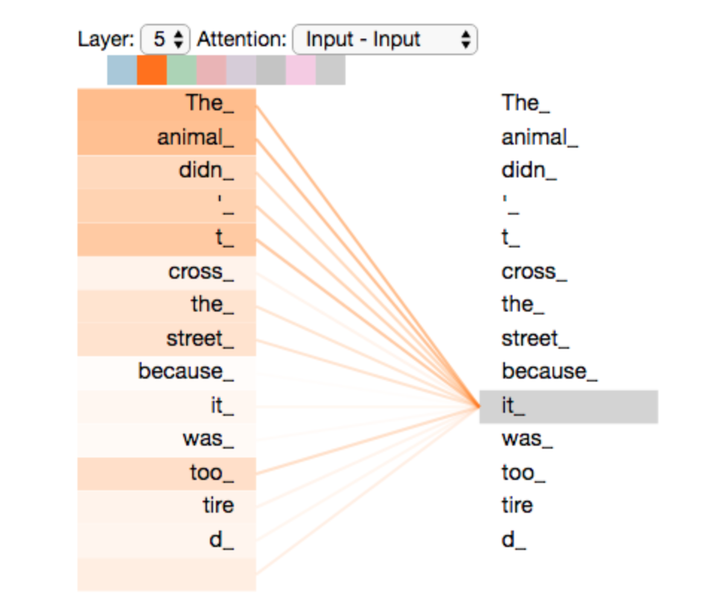
Self-Attention
Self-attention relates different positions of a single sequence in order to compute a representation of the same sequence
Find relationships between different words in a sentence to compute their representation
They try to understand each other better in mutual context
https://jalammar.github.io/illustrated-transformer

Slide 6
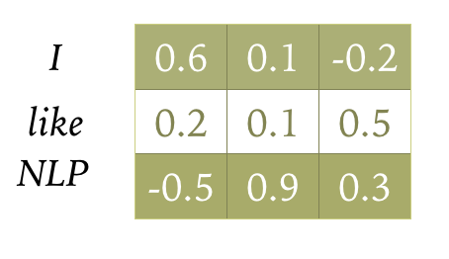
Self-Attention
How to create word-level input representation ?

Slide 7
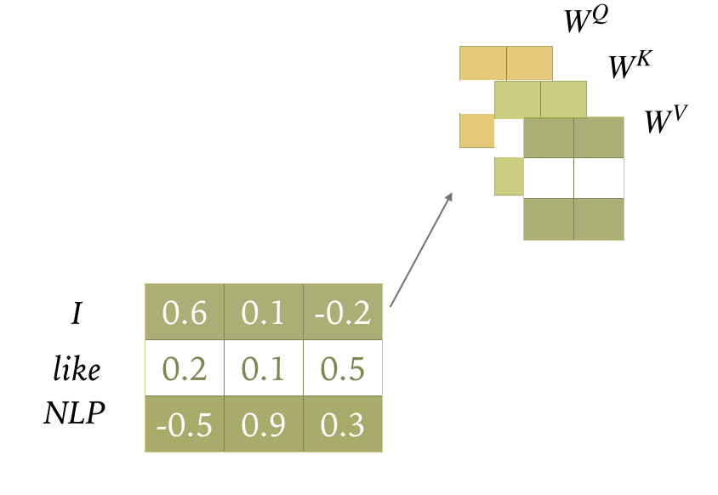
Self-Attention
Create query, key and value projections of encoder states
Weight matrices W^{Q}, W^{K} and W^{V} project each input into a representation of its role as a key k, query q or value v

Slide 8
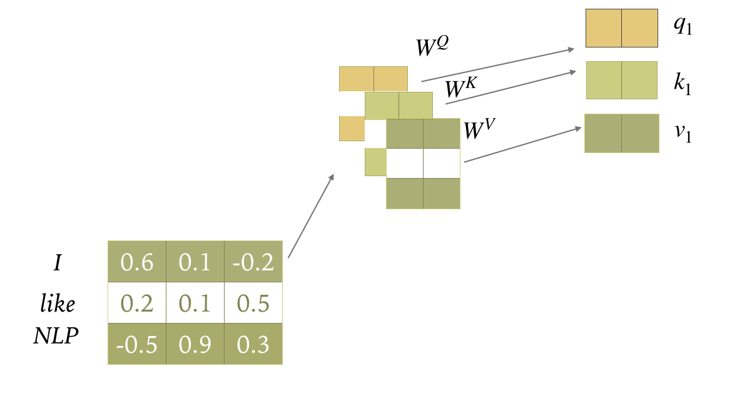
Self-Attention

Slide 9
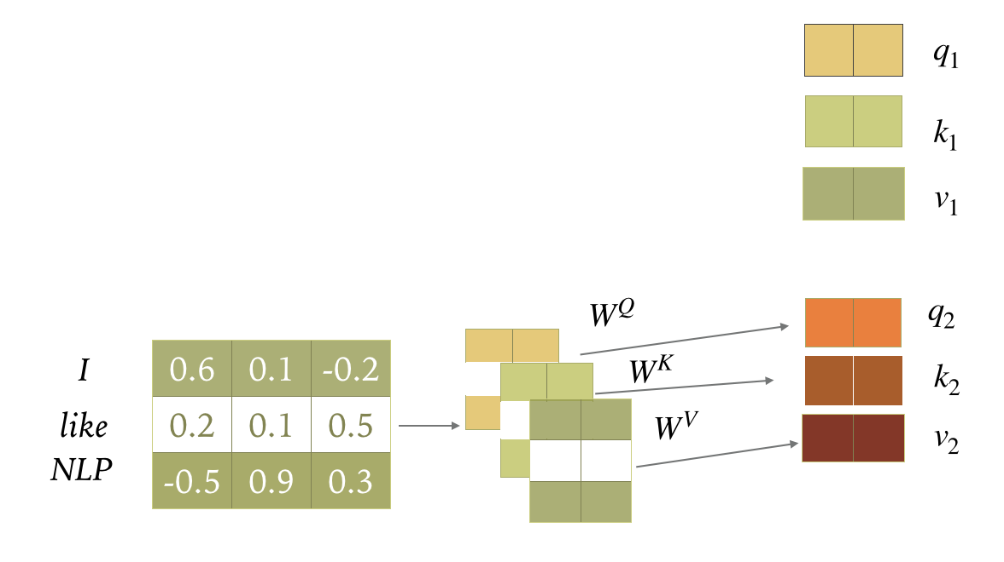
Self-Attention

Slide 10
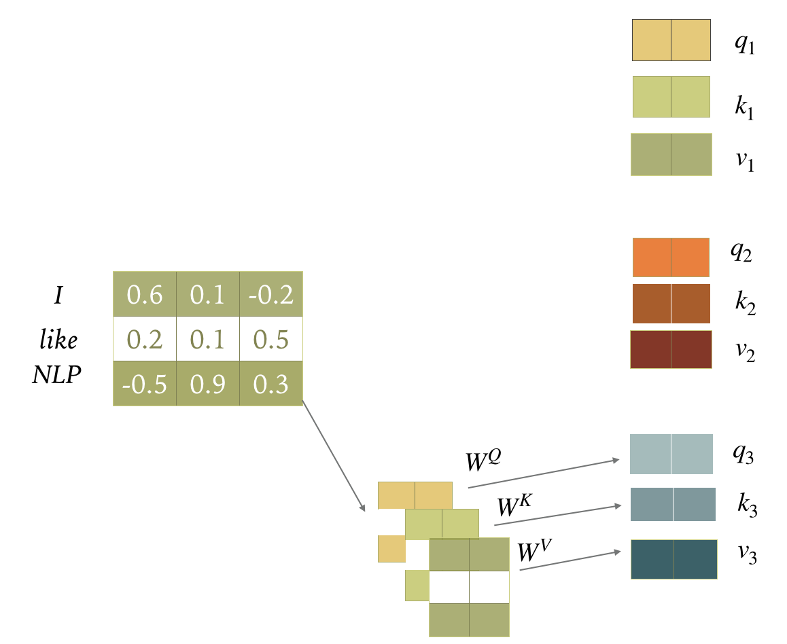
Self-Attention

Slide 11
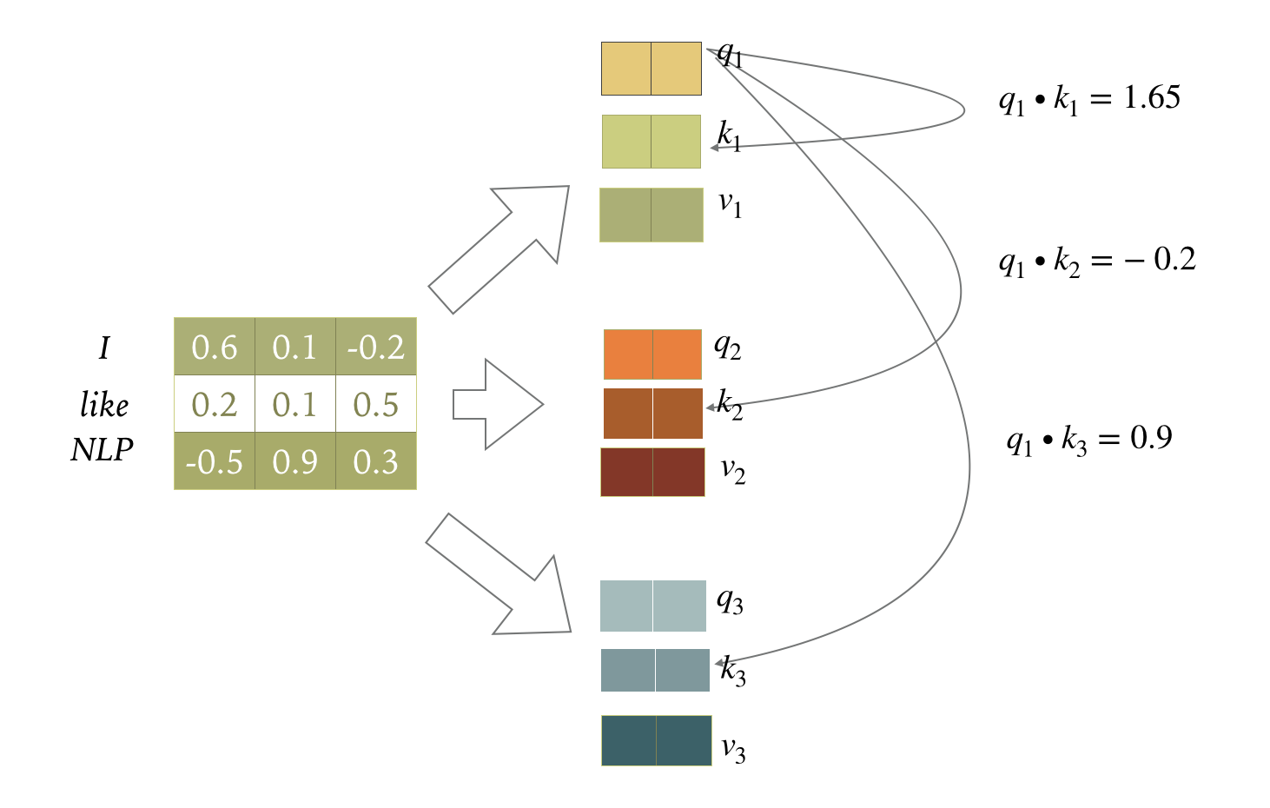
Self-Attention
Compute scores as dot product of q and k

Slide 12
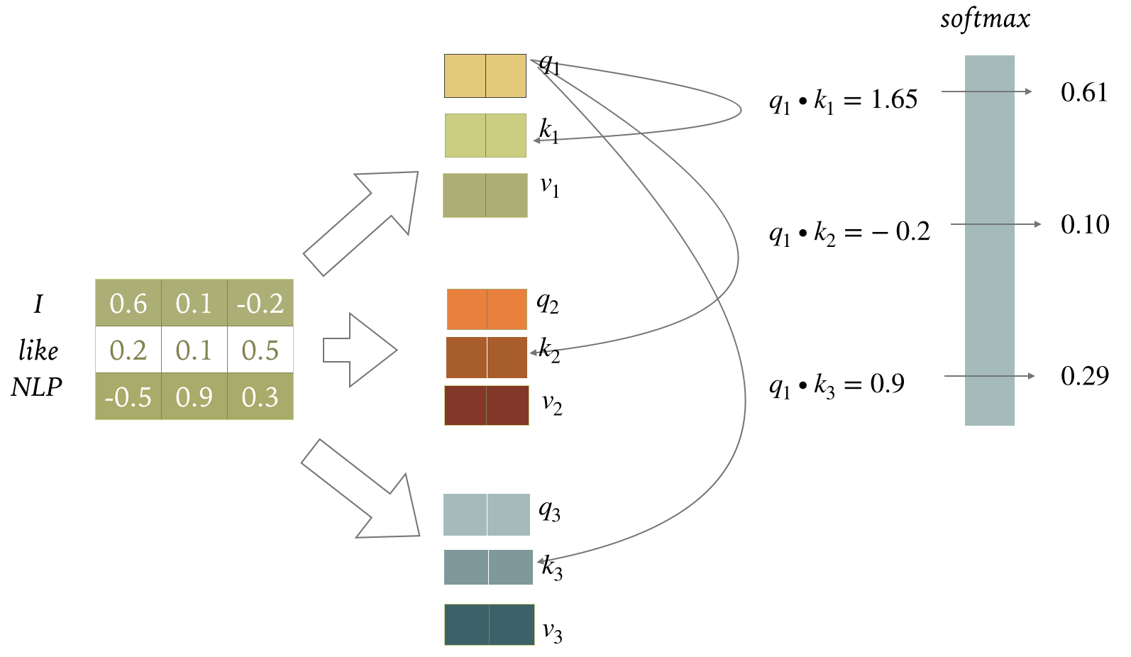
Self-Attention
Softmax score determines the importance of words in a sequence for a position

Slide 13
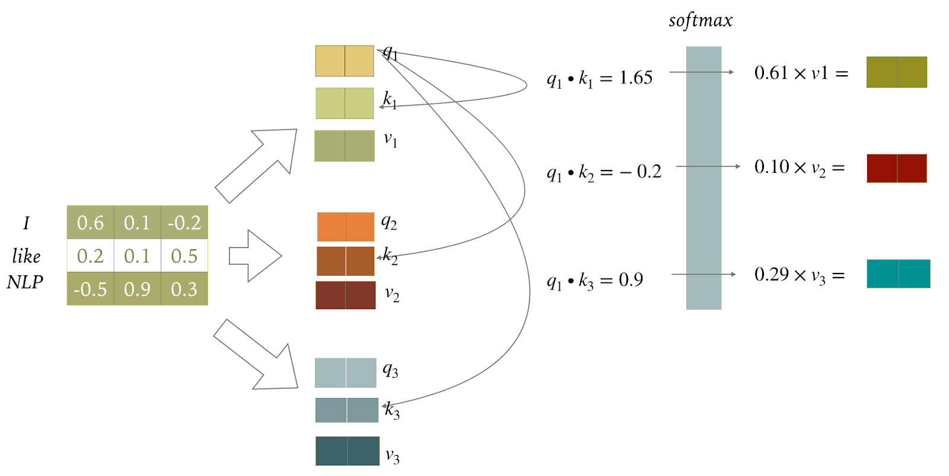
Self-Attention

Slide 14
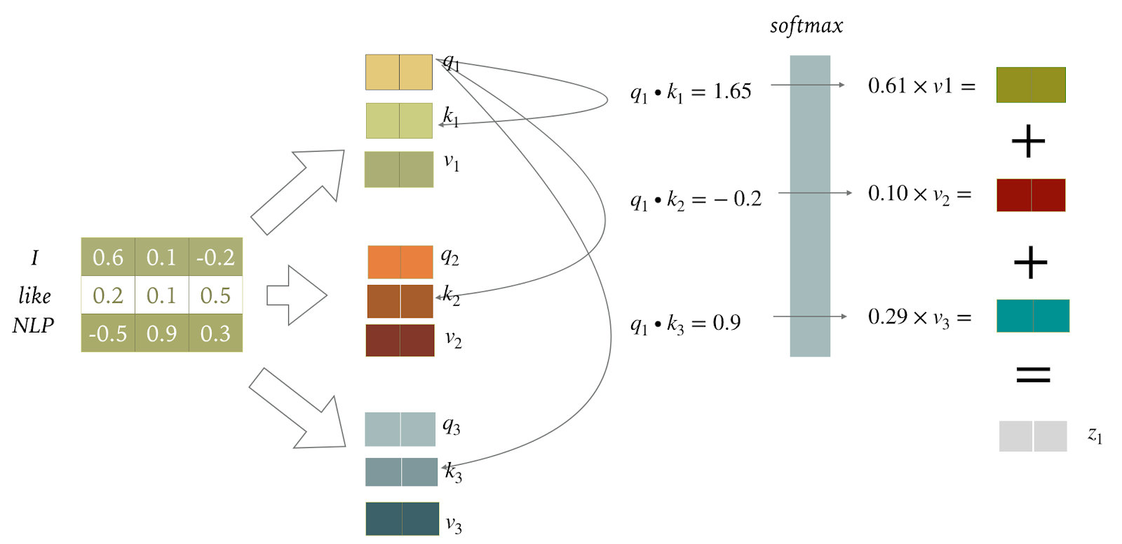
Self-Attention
For each position we get the weighted sum over the value vectors v

Slide 15
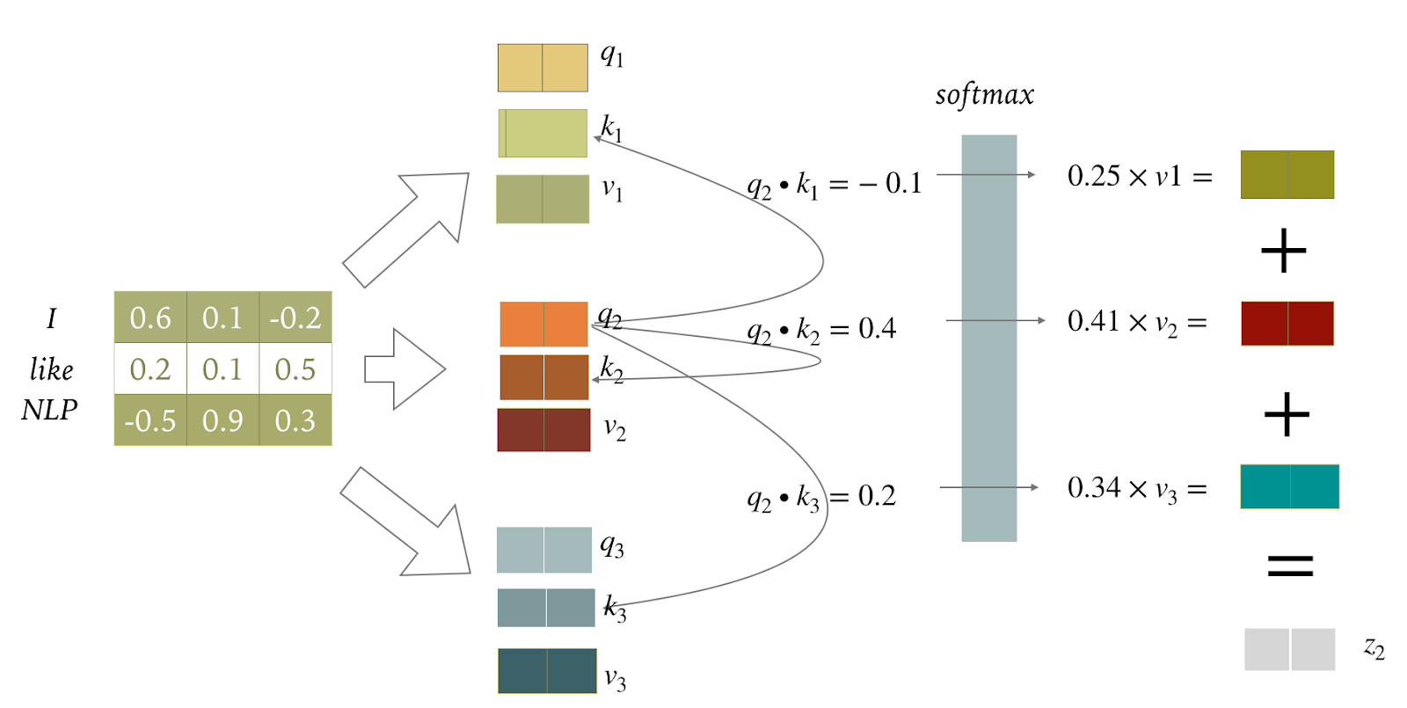
Self-Attention

Slide 16
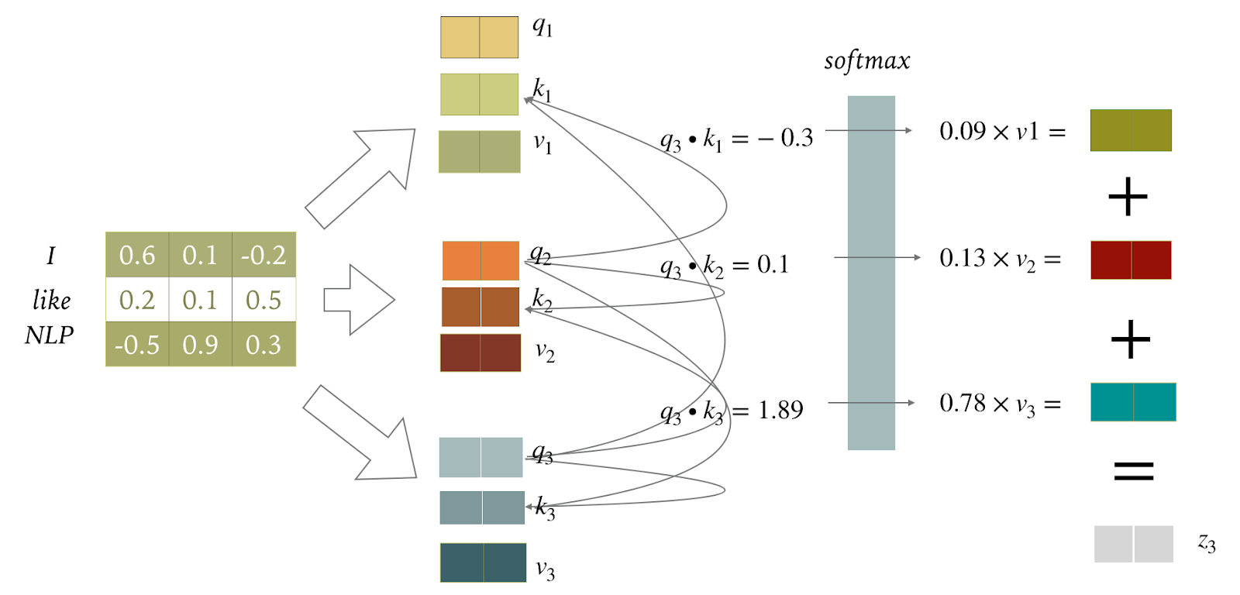
Self-Attention

Slide 17
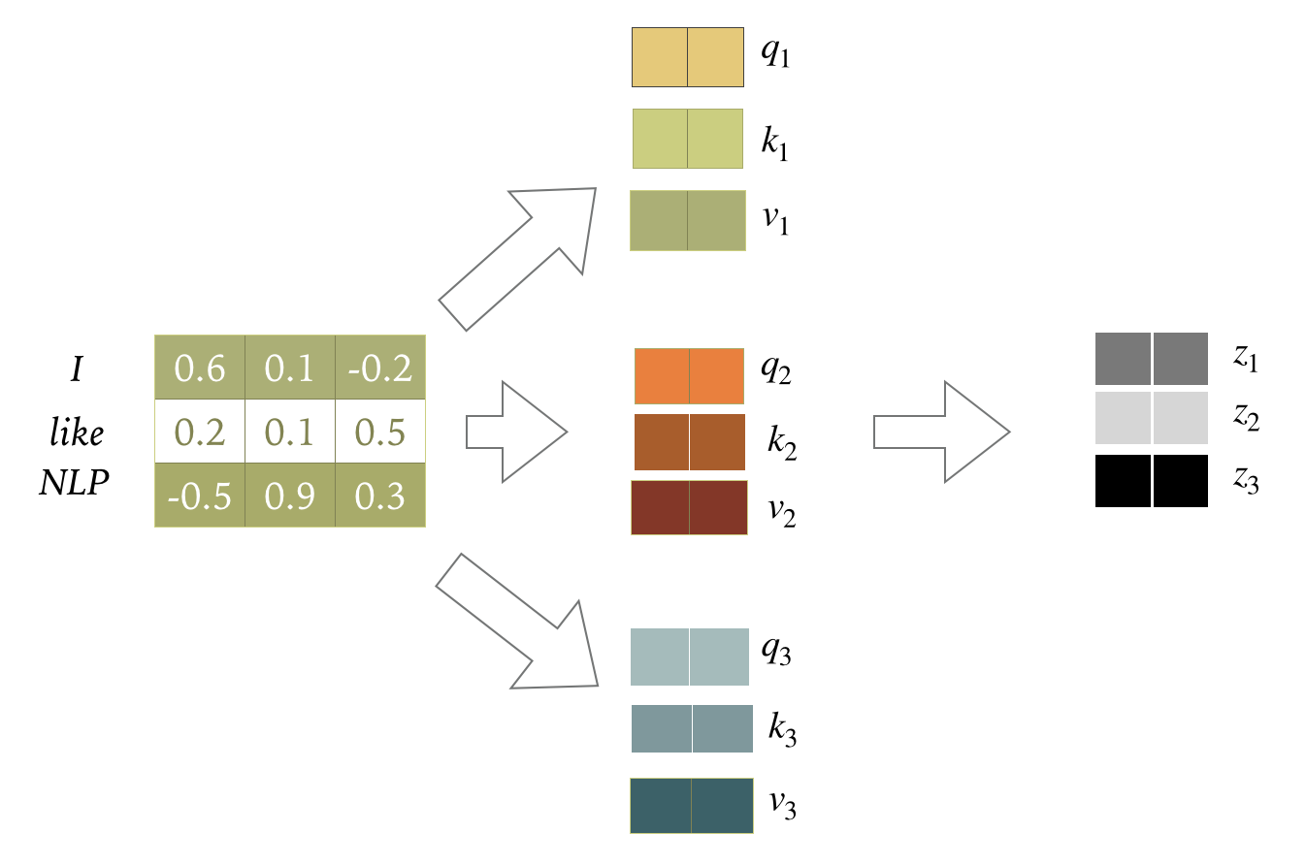
Self-Attention
Output of the self-attention layer at all the three positions

Slide 18
Multi-Head Self-Attention
Different words in a sentence can relate to each other in many different ways simultaneously: syntactic, semantic, and discourse relationships, etc.
Difficult for a single transformer block to learn to capture all of them in parallel
Transformer uses several self-attention layers stacked in parallel, with different linear transformations (heads) of the same input at the same depth in a model, each with its own set of parameters
They can learn different aspects of the relationships that exist among inputs at the same level of abstraction

Slide 19
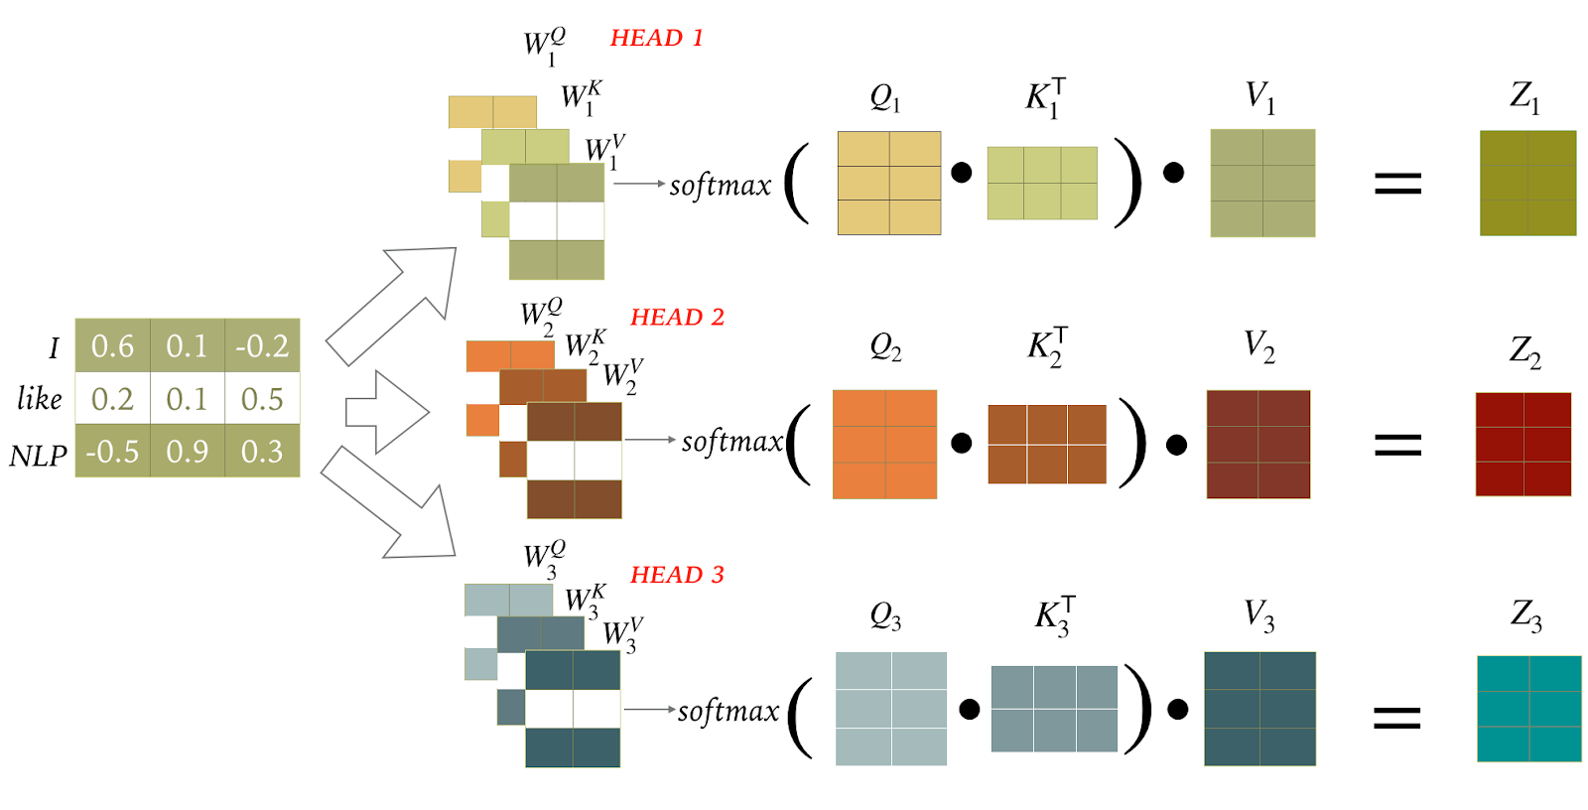
Multi-Head Self-Attention
Implementation with matrix calculation
Each head is provided with its own set of key, query and value matrices to create separate projections per head

Slide 20
Multi-Head Self-Attention
Outputs of heads are concatenated, then another linear projection is used to reduce dimensionality

Slide 21
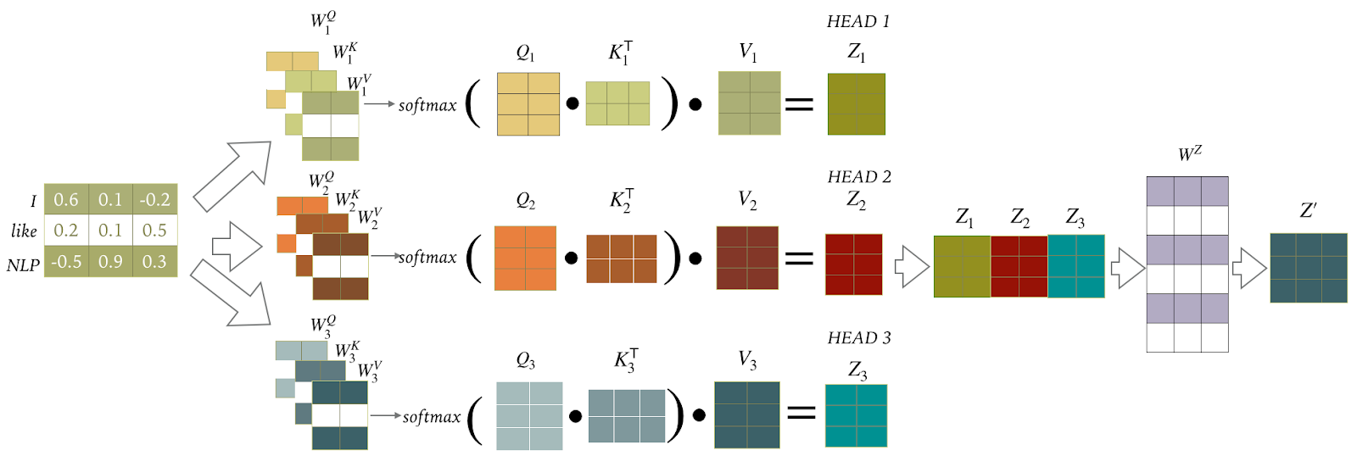
Multi-Head Self-Attention

Slide 22
Multi-Head Self-Attention

Slide 23
Multi-Head Self-Attention
Different heads are shown to capture different relationships only a small number of heads are important for translation
These heads play interpretable "roles”:
Positional: attend to a token's immediate neighbours
Syntactic: learned to track some major syntactic relations
https://lena-voita.github.io/posts/acl19_heads.html

Slide 24
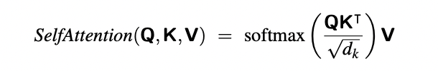
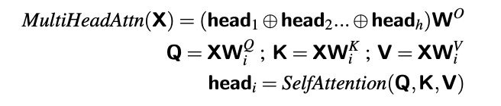
Multi-Head Self-Attention
Scaled Dot-Product Attention in Transformers
Q, K and V are query, key and value matrices respectively
d_{k} is the dimensionality of the key vectors
Dot product is scaled to avoid numerical issues by a factor related to the size of the embeddings

Slide 25
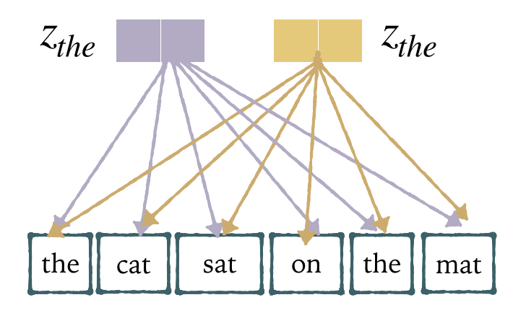
Positional Encoding
Architecture intrinsically has no notion of word order
One simple solution: modify the input embeddings by combining them with positional embeddings (PE)

Slide 26
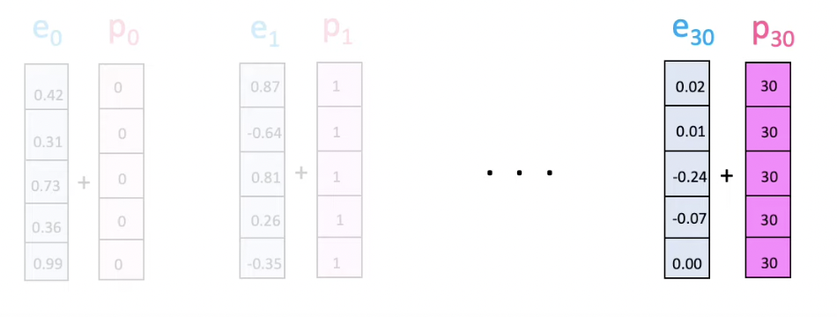
Positional Encoding
Simple absolute position embedding (PE) approach will not generalise well
Embeddings for the positions at the outer length limits may be poorly trained
https://www.youtube.com/watch?v=dichIcUZfOw

Slide 27
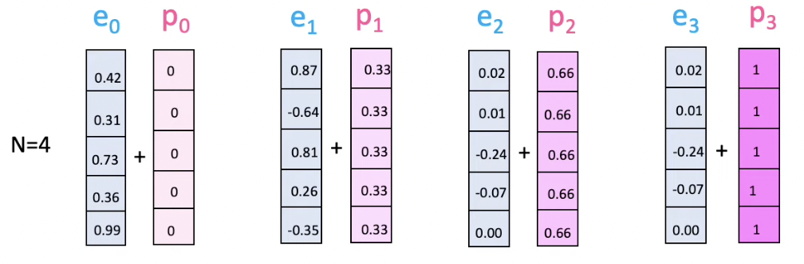
Positional Encoding
PE with fractions will not be the same for the same positions across examples
https://www.youtube.com/watch?v=dichIcUZfOw

Slide 28
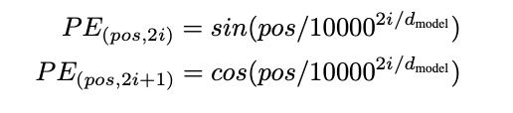
Positional Encoding
Choose a static function that maps integer inputs to real-valued vectors to capture relationships among the positions, i.e., position 2 is closer to position 3 than to 18
Original Transformer model uses a combination of sine and cosine functions with differing frequencies:
d-dimensional vector that contains position information: both position (pos) and dimension i are important
Keep the original embedding dimensionality: PE are summed with input embeddings

Slide 29
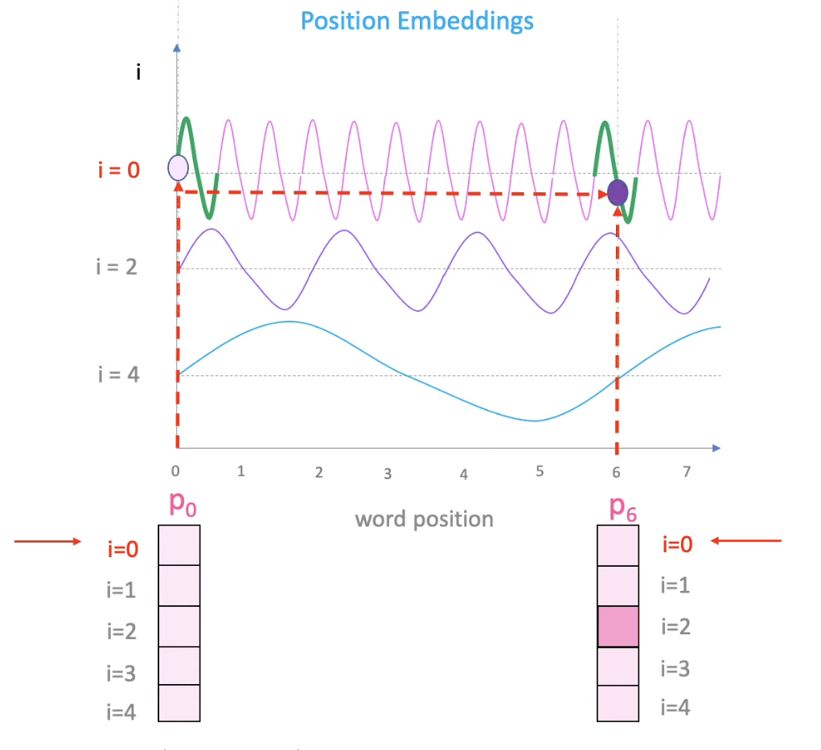
Positional Encoding
Each dimension i of the positional encoding is a sine or cosine wave with a different frequency
https://kazemnejad.com/blog/transformer_architecture_positional_encoding/

Slide 30
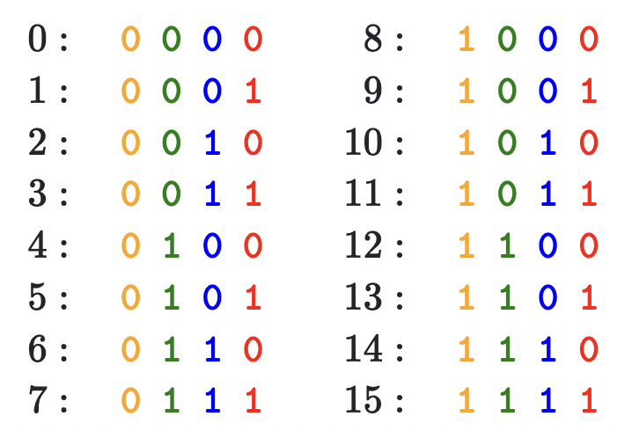
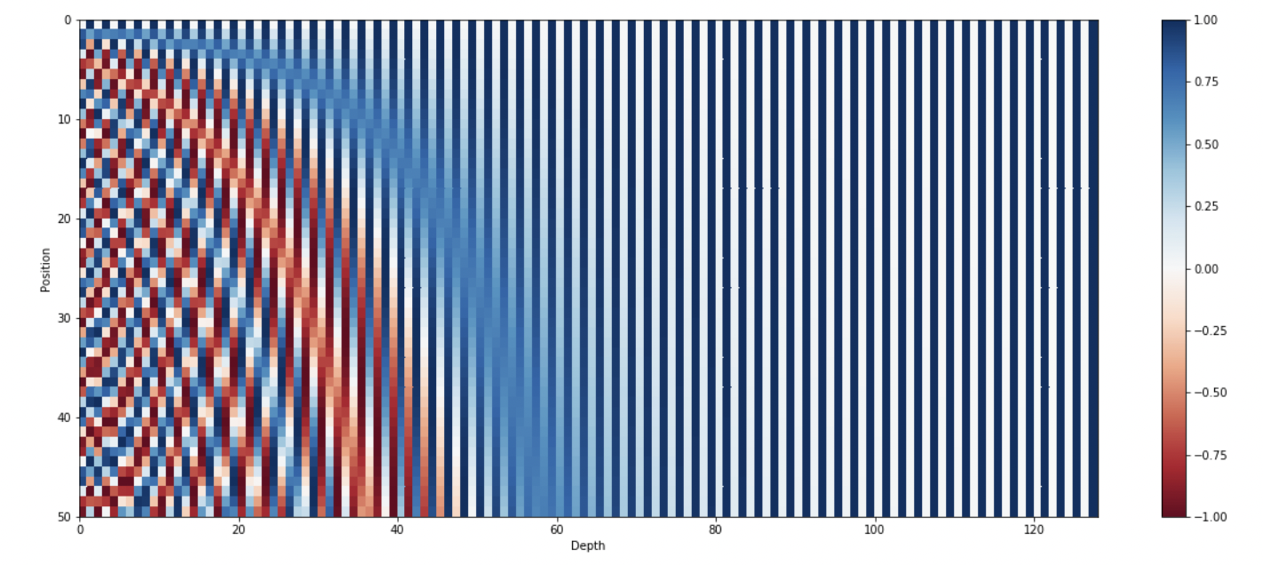
Positional Encoding
Combination of sines and cosines can represent a position/order
Sinusoidal functions are float continuous counterparts of alternating bits that reflect rate of change between different bits
128-dimensional positonal encoding for a sentence with the maximum lenght of 50. Each row represents the embedding vector.
https://kazemnejad.com/blog/transformer_architecture_positional_encoding/

Slide 31
Key Takeaways
Model that relies entirely on an attention mechanism to learn dependencies between input and output
Self-attention is the core of the model and allows the model to relate different positions of a single sequence in order to compute a representation of the same sequence
Multi-head self-attention allows the model to jointly attend to information from different representation sub-spaces at different positions
Positional encoding allows the model to easily learn to attend by relative position since the model intrinsically has no notion of the order of inputs

